Slide 1
Introduction to Database Management system
Lecture-1

Slide 2

DATA and INFORMATION
To understand what is database, first we need a brief understanding of about DATA and INFORMATION
What is DATA?
Data: In simple words data is raw, isolated facts about an entity or an object which is stored in recorded form. For example, text, audio, image, video etc.
What is INFORMATION
Information: It is a processed, meaningful and usable data.
5 is a DATA or INFORMATION

Slide 3
DATABASE and DBMS
Database: It is a systematic collection of similar or related data. If the data is not related, we cannot extract the relevant information from it. Database makes data management easy. For example, video is data, but YouTube is a database. Image is data but Instagram is a database.
Database Management System: It is a program which enables the user to create, manipulate and delete database. It is also used for controlled access to database.

Slide 4
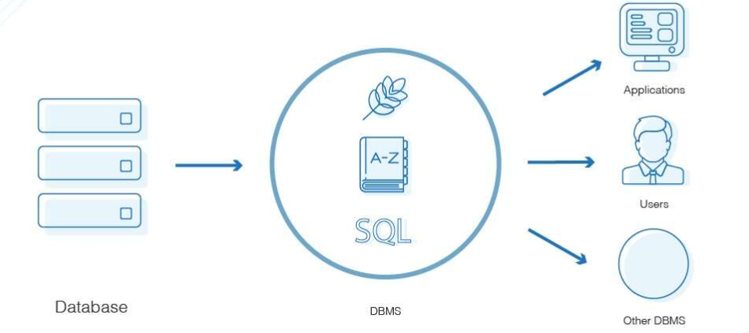
Database Management System

Slide 5
Why we need database management system?
Because there are disadvantages of using file system

Slide 6
Data Inconsistency
Data Redundancy
Difficulty in accessing data
Atomicity Problem
Data Isolation
Concurrent access anomalies
Security Problems

Slide 7
Operations on Database
•To add new information
• To view or retrieve the stored information
• To modify or edit the existing
• To remove or delete the unwanted information
• Arranging the information in a desired order etc.

Slide 8
Components of Database system
There are five major components of database system
Hardware
Software
Data
Users
Procedures

Slide 9
Applications of Database
Banking: transactions
Railway: reservations and schedules
Online retailing: order submit, order tracking, customized recommendations etc.
Manufacturing: Inventory, productions, etc.
And so on

Slide 10
QUIZ time
University Management System (UMS) is an application of Database
Yes
No

